Slide 1
The role of citizens in the fight against corruption
Khachik Harutyunyan
Anti-corruption expert

Slide 2
General overview of the situation
Corruption Perception Index 2015-Armenia ranks 95th place among 168 countries with 35 points, Azerbaijan 119th place (29), Russia the same place with the same scores, Georgia 48 (52), Iran 130 (27), Turkey 66 (42). The leaders are Denmark, Finland and Sweden.
Policy forum Armenia 2013-Armenia lost $5.9 billion in 2013 because of corruption, and instead of a GDP of $10.5 billion in 2013, it would have had $16.4 billion, if only it had had a level of governance comparable to Botswana and Namibia
Global financial integrity “Illicit financial flows from developing countries: 2004-2013” 2015report - among 149 countries Armenia occupies 70th place and its average financial flows from the country for the period of 2004-2013 equals to 983 million of USD

Slide 3
Karl Kraus
Corruption is worse than prostitution. The latter might endanger the morals of an individual, the former invariably endangers the morals of the entire country.

Slide 4
Global Corruption Barometer 2013
TO WHAT EXTENT DO YOU AGREE THAT ORDINARY PEOPLE CAN MAKE A DIFFERENCE IN THE FIGHT AGAINST CORRUPTION?
Armenia-63% disagree, 37% agree
Bangladesh-8% disagree, 92% agree
Zimbabwe-44% disagree, 56% agree
Malawi-16% disagree, 84% agree
Mozambique-37% disagree, 63% agree

Slide 5
Caucasus Barometer 2015 and survey on consumers 2015
73% of respondents consider the state as a ''Parent'' and not as an ''Employee'‘
48% thinks that criticizing government is necessary to be a good citizen while 44% thinks that it is not. In Georgia it is 68% who are opponents of criticizing
49% considers that people are masters of their fate, in Georgia 39% thinks so
According to a survey conducted in 2015 by Food Safety Service-85% of respondents just would put back to the shelves expired products and only 39% would complaint

Slide 6
A BIG WHY? Collective action problem
Briggite Zimmerman (Scholar of comparative politics, focus political economy of corruption)
One reason for the failure of anti-corruption interventions may be that citizens don’t care enough about the corruption that’s brought to light to mobilize against it, also known as the classic collective action problem.

Slide 7
A BIG HOW?

Slide 8
Constitution of Bhutan
Article 8
FUNDAMENTAL DUTIES
Every person shall have the duty to uphold justice and to act
against corruption.

Slide 9
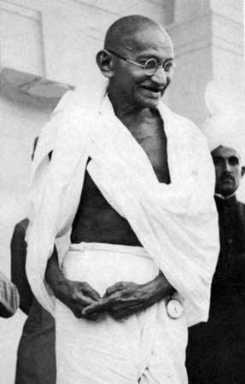
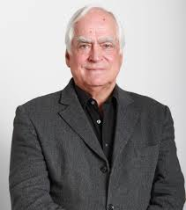
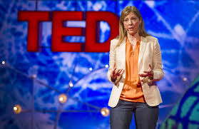
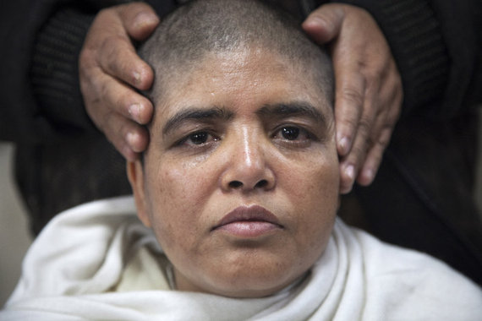

Slide 10
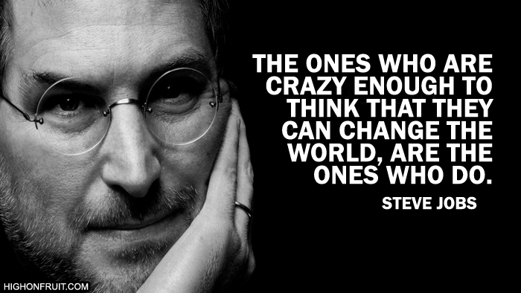
Some Awesome people

Slide 11
How? Talk-don’t be silent

Slide 12
How? Anti-corruption kit. 15 ideas for young activists. Developed by TI Berlin

Slide 13
Some great examples: Sharada Bhusal Jha (Nepal)
3 hunger strikes during last 3 years
1999-Village council meeting
2014-13 days hunger strike
More than 1,000 cases of corruption charges
She shaved her head and wore white outfit, a ritual often performed in the name of dead family members. According to her, the government was no longer "alive" for the people.
Motivated Pradeep Baral (Nepal Commerce Campus)
Few charges

Slide 14
Mother Teresa-inspiration of the century

Slide 15
Empower citizens
to fight for Armenia
free of corruption

