Slide 1
Citizen-led anti-corruption
Khachik Harutyunyan
Anti-corruption expert
Transparency International Anti-corruption Center NGO

Slide 2
Karl Kraus
Corruption is worse than prostitution. The latter might endanger the morals of an individual, the former invariably endangers the morals of the entire country.

Slide 3
Global Corruption Barometer 2013
TO WHAT EXTENT DO YOU AGREE THAT ORDINARY PEOPLE CAN MAKE A DIFFERENCE IN THE FIGHT AGAINST CORRUPTION?
Armenia-63% disagree, 37% agree
Bangladesh-8% disagree, 92% agree
Zimbabwe-44% disagree, 56% agree
Malawi-16% disagree, 84% agree
Mozambique-37% disagree, 63% agree

Slide 4
A BIG WHY? Collective action problem
Briggite Zimmerman (Scholar of comparative politics, focus political economy of corruption)
Through a survey experiment on citizens, I show that citizens use their limited resources to fight corruption when it is immediate to their lives (for example, stealing food subsidies), but that we should not expect citizens to mobilize against forms of corruption that are not as immediate (for example, obtaining per diem for workshops that were not attended).
One reason for the failure of anti-corruption interventions may be that citizens don’t care enough about the corruption that’s brought to light to mobilize against it, also known as the classic collective action problem. Those designing anti-corruption initiatives can incentivize citizens to participate by understanding and emphasizing the more immediate effects of corruption.

Slide 5
The role of media
Susan Rose-Ackerman (Professor of Law and Political Science at Yale)
If the local media are weak and dependent on either the government or
wealthy private interests, then outside actors can help to support any remaining independent outlets, and can engage in reporting activities independent of local entities.

Slide 6
A BIG HOW?

Slide 7
Constitution of Bhutan
Article 8
FUNDAMENTAL DUTIES
Every person shall have the duty to uphold justice and to act
against corruption.

Slide 8
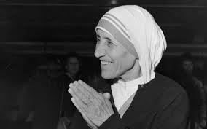
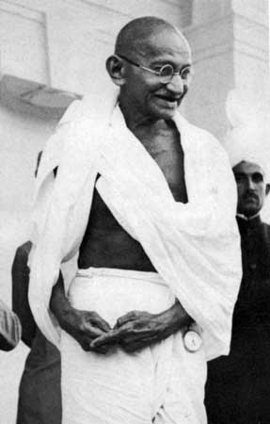
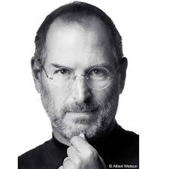
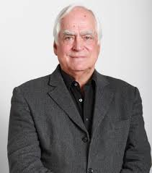
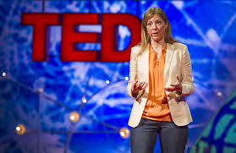
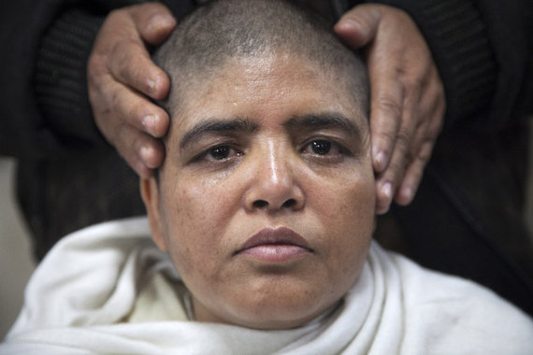

Slide 9
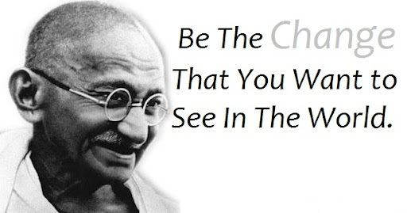
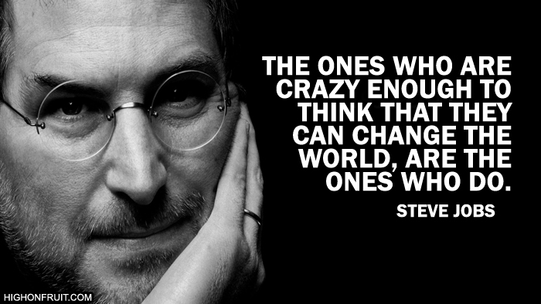
Some Awesome people

Slide 10
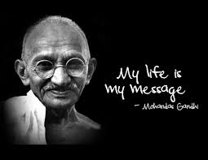
How? Talk-don’t be silent

Slide 11
How?
Jesper Johnson (U4 Anti-corruption research center, Christen Michelsen Institute, Norway)
Structural observations (photo,video)
Exit surveys
Focus group discussions
Rapid surveys (few questions)
Web-based surveys
Electronic surveys

Slide 12
How? Anti-corruption kit. 15 ideas for young activists. Developed by TI Berlin

Slide 13
Some great examples:
Sharada Bhusal Jha (Nepal)
3 hunger strikes during last 3 years
1999-Village council meeting
2014-13 days hunger strike
More than 1,000 cases of corruption charges
She shaved her head and wore white outfit, a ritual often performed in the name of dead family members. According to her, the government was no longer "alive" for the people.
Motivated Pradeep Baral (Nepal Commerce Campus)
Few charges

Slide 14
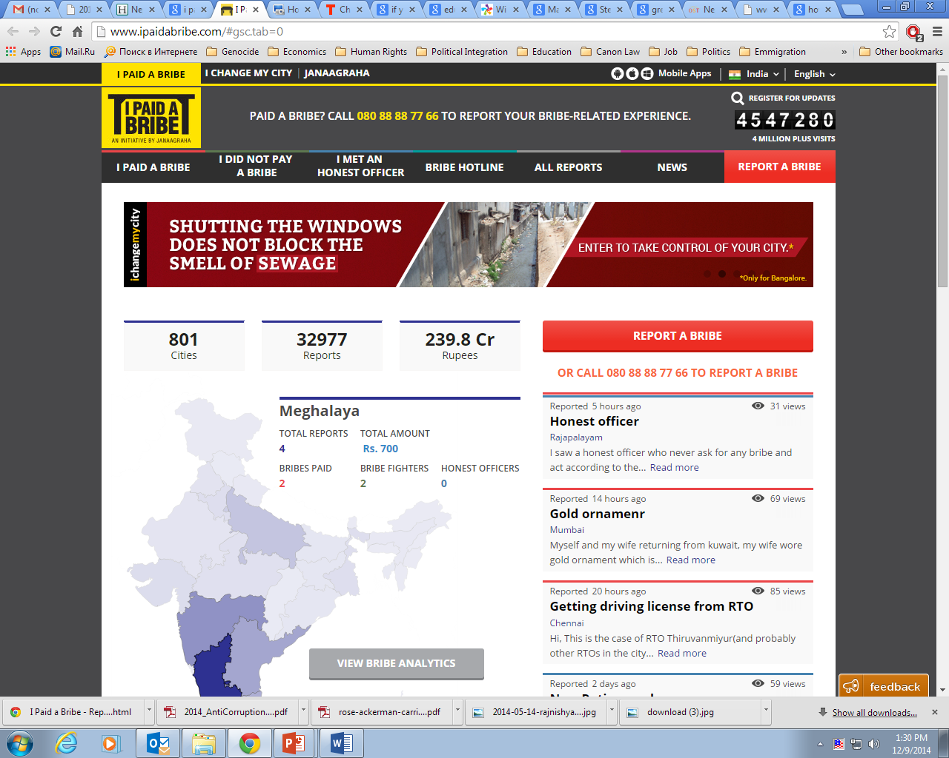
Some great examples: Ramesh Ramanatan and Swati from India –Janaagraha, since 2001
I paid a bribe and I change my city

Slide 15
Some examples: Anna Hazare India
Jan Lokpal Bill, also referred to as the Citizen's Ombudsman Bill-an independent body to investigate corruption cases
2011-2012
Top 10 stories of 2011-Time magazine

Slide 16
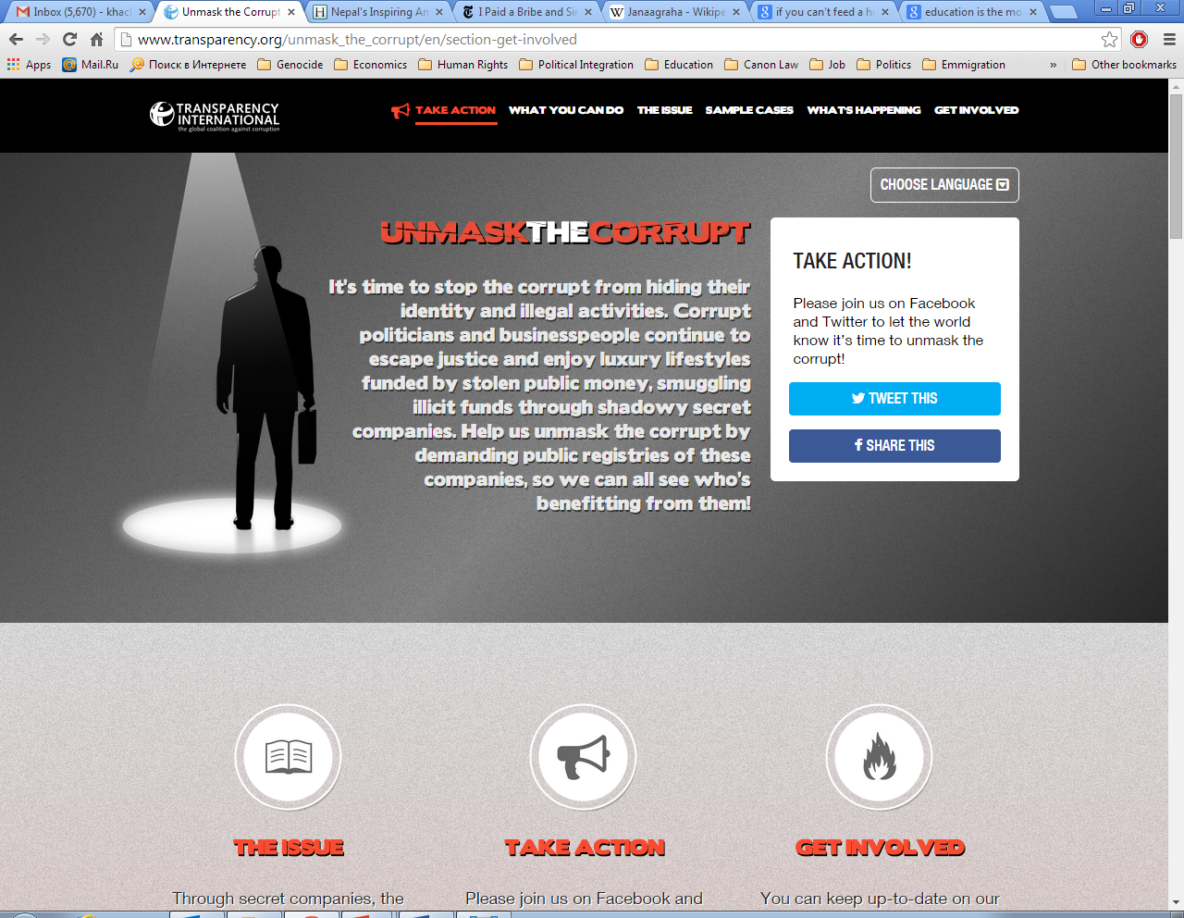
Unmask corrupt-Beneficial ownership http://www.transparency.org/unmask_the_corrupt/en/section-get-involved

Slide 17
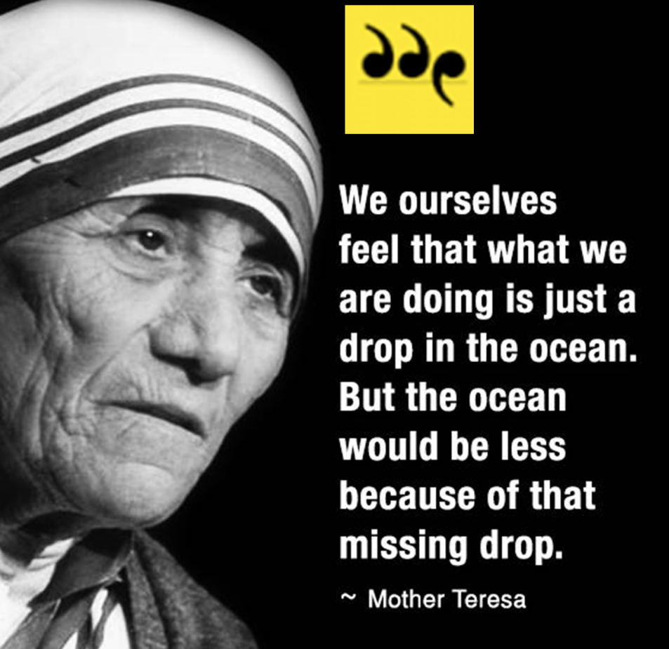
Mother Teresa-inspiration of the century

Slide 18
Work without Love is slavery
What is anti-corruption fight without having love to your fellow citizens???
It is just fight, which one can loose if his/heart doesn’t shrink from the made injustice by those who have authorities toward his/her fellows

